Slide 1
Unit 11
How was your school trip?
Section B 2a-2c
七年级下册

Slide 2

Revision
What was your last school trip like?
I went to…
That sounds…

Slide 3
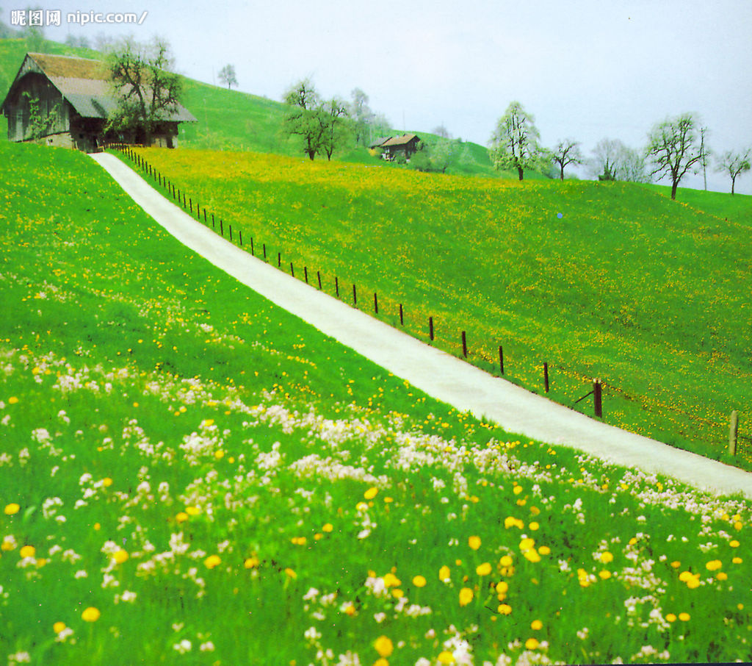
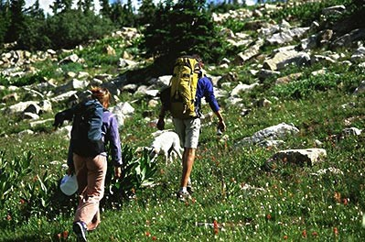
went to the countryside
climbed a mountain

Slide 4
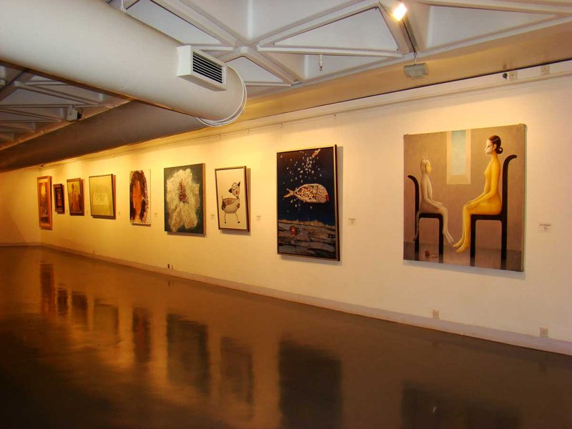
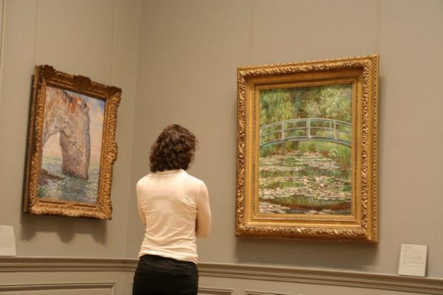
went to an art museum
saw some paintings

Slide 5
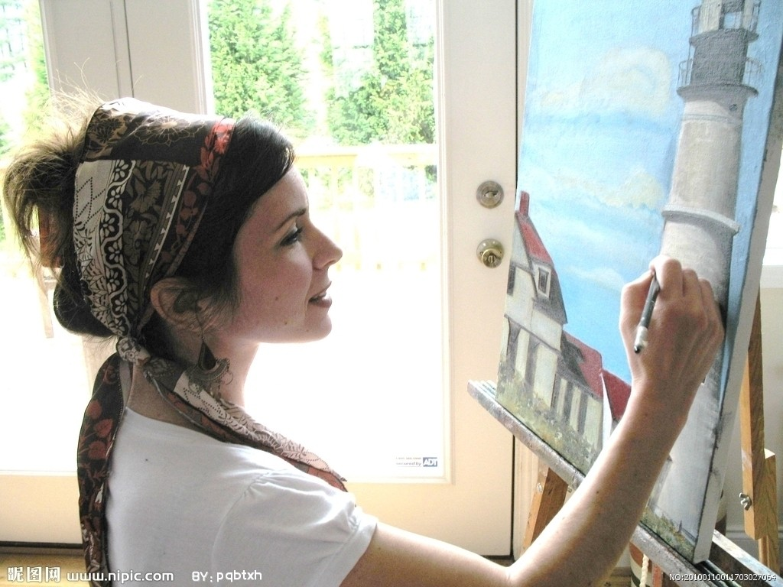
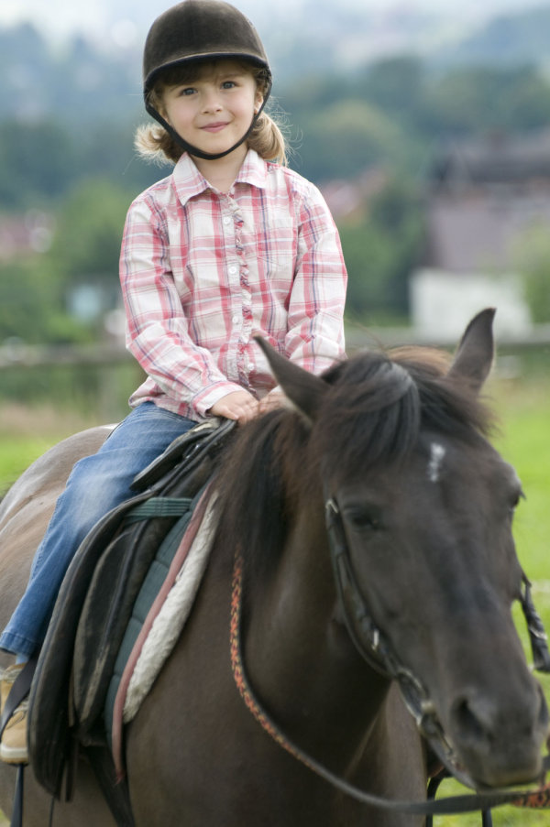
drew pictures
rode a horse

Slide 6

Objectives
To read Helen’s and Jim’s diary entries
To learn to write a diary entry for your own school trip using The past simple tense

Slide 7
2a. Do the following words describe good things or bad things? Put a √ for good and × for bad . Leave a blank if they can mean both.
√
×
√
___interesting ___ difficult ___lovely ___slow
___exciting ___boring ___ cool ___ hot
___lucky ___large ___ expensive ___ terrible
___delicious ___ great ___ cheap ___ fast
√
×
√
√
√
×
×
√
√

Slide 8
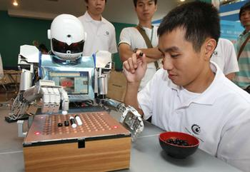
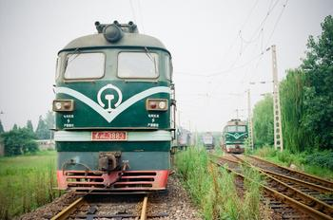
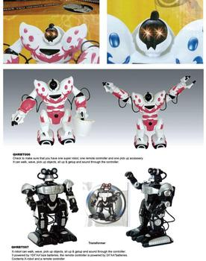
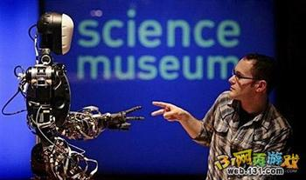
Lead in
science museum

Slide 9


2b. Read Helen’s and Jim’s diary
entries and answer the questions.
1. Did Helen and Jim go on the same trip?
2. How do they feel about the trip?

Slide 10
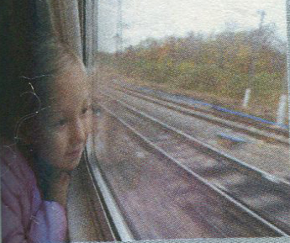
June 15th
Today I went on a school
trip. We visited the science
museum and it was really
interesting. We got there so
fast by train. We saw farms
and villages along the way.
At the museum, I learned a lot about robots.
I didn’t know they could play chess with us.
It was so cool! Then the guide taught us how
to make a model robot. I took a lot of great

Slide 11


photos, too. After that, I went to the gift shop
and bought some lovely gifts for my parents.
They weren’t expensive. All in all, it was an
exciting day.

Slide 12
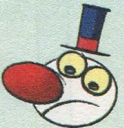
June 15th
I think today’s school trip was terrible. We took the train to the museum. It was so hot on the slow train. The museum was big and boring. Everything was about robots and I’m not interested in that. The rooms were really dark and it was difficult to take photos, so l didn’t take any. There were also too many people and I couldn’t really see or hear the guide. The things in the gift shop were so expensive. I didn’t like the trip at all.

Slide 13
1. Did Helen and Jim go on the same trip?
_____________________________________
2. How do they feel about the trip?
_____________________________________
_________________________
Yes, Helen and Jim went on the same trip.
Helen thought the trip was great, but Jim
didn’t like the trip at all.

Slide 14

Sharing your ideas
What do you think of Helen’s and Jim’s trip?
In my opinion …

Slide 15
2c. Complete the chart. How do
Helen and Jim describe these
things?
 | Helen | Jim
the trip
the train
the museum
the gift shop and gifts
exciting
terrible
fast
slow
big, boring, dark,
too many people
interesting
lovely,
cheap
so expensive

Slide 16

Language points

Slide 17


1. All in all, it was an exciting day.
总之，这是令人兴奋的一天。
all in all 总的说来；总之；整体上说
All in all, I think you did a good job.
总的说来，我认为你干得很好。
All in all, it was a great success.
总之，是很成功的。
Practise
总而言之，这样更严格和专业。
All in all, it is more serious and professional.

Slide 18
2. It was so hot on the slow train.
慢车上是那么的热。
slow train “慢车”，还可以说stopping train。与之相对应的“快车”，英语是fast train, 却不是quick train。
It is a slow train, not an express.
这是一列慢车，不是快车。
Practise
为缩短路上所花的时间，我一般不买普客票。
To reduce time wasted on the journey, I
usually don’t take the slow train.

Slide 19
3. Everything was about robots and I’m not interested in that.
be interested in 对……感兴趣
They want to be interested in what they are doing.
他们总希望对正在做着的事充满浓厚兴趣。
Practise
他对画画很有兴趣。
He is interested in painting.

Slide 20
4. I didn’t like the trip at all.
我一点都不喜欢这次行程。
not at all/not…at all相当于“根本不; 完全不”。
I don’t like mutton at all.
这羊肉我一点都不喜欢。
She’s not at all good at badminton.
她完全不擅长打羽毛球。
Practise
我一点也不喜欢英语。
I don’t like English at all.

Slide 21
5. today’s school trip
表示有生命的东西的名词及某些表示时间、距离、星球、世界、国家等无生命的东西的名词后加 ’s来表示所有关系，叫做名词所有格。
例如: men’s room 男厕所
a mile’s distance 一英里的距离
但如果该名词是以-s或-es接尾，则只在该名词后加“’”来构成所有格。
例如: 3 hours’ walk 三小时的路程
five minutes’ walk 五分钟路程
two miles’ distance 两英里的距离

Slide 22
Review
课时重点回顾
1. play… with…
2. all in all
3. slow train
4. be not interested in…
5. not… at all

Slide 23

Spelling Bee
Now 2 means to test your spelling.
1. English-Chinese
exciting expensive robot guide hear
2. Chinese-English
便宜的；缓慢的；所有事物，一切；
感兴趣的；黑暗的；可爱的
When finished, exchange your papers to see who does the best.

Slide 24


Slide 25
Ⅰ. 根据对话内容用合适的单词填空，补全对话。
A: Where did your class go on last school
trip?
B: We ________ to the beach.
A: To the beach? What did you do there?
B: Some of us went swimming and others
walked on the beach.
A: That _______ great. I would like to go
there some day.
went
sounds

Slide 26
B: And what ____ your class do ____ the
school trip?
A: We went hiking in the mountain.
B: Go hiking? I know it’s an exciting sport.
____ was your school trip?
A: Well, we felt tired, but we ___ a lot of
fun.
B: Great! I hope I can join you next time.
did
for
How
had

Slide 27
Ⅱ. Translate and write them down.
1. 我一点都不喜欢那次旅行。
2. 我们参观了科学博物馆，这很有趣。
I didn’t like the trip at all.
We visited the science museum and it was really interesting.

Slide 28
3. 之后，我去礼品店给我父母买了一些好
看的礼物。
After that, I went to the gift shop and
bought some lovely gifts for my parents.
4. 我们昨天乘火车去了博物馆。
We took the train to the museum
yesterday.
5. 我从来不知道机器人可以跟我们下棋。
I didn’t know the robots could play chess
with us.

Slide 29
Ⅲ. 根据句意及汉语提示完成单词。
1. We learned a lot about history in the ________(博物馆).
2. Alice is a smart and ________(可爱的) girl.
3. — Why didn’t you buy the iPhone?
— Because it was too __________(昂贵的).
4. He went to the shop and bought some ________(礼物) for his friends.
5. I’m sorry, I didn’t ________(听到) what you said.
museum
lovely
expensive
gift
hear

Slide 30
Ⅳ. 用所给单词的正确形式填空。
1. Yesterday we ________(visit) the art museum.
2. Can you teach me how ________(swim)?
3. I think it’s difficult __________(learn) English well.
4. Let’s go ________(fish) this weekend.
5. Helen is __________(interest) in music. She wants to be a musician.
visited
to swim
to learn
fishing
interested

Slide 31
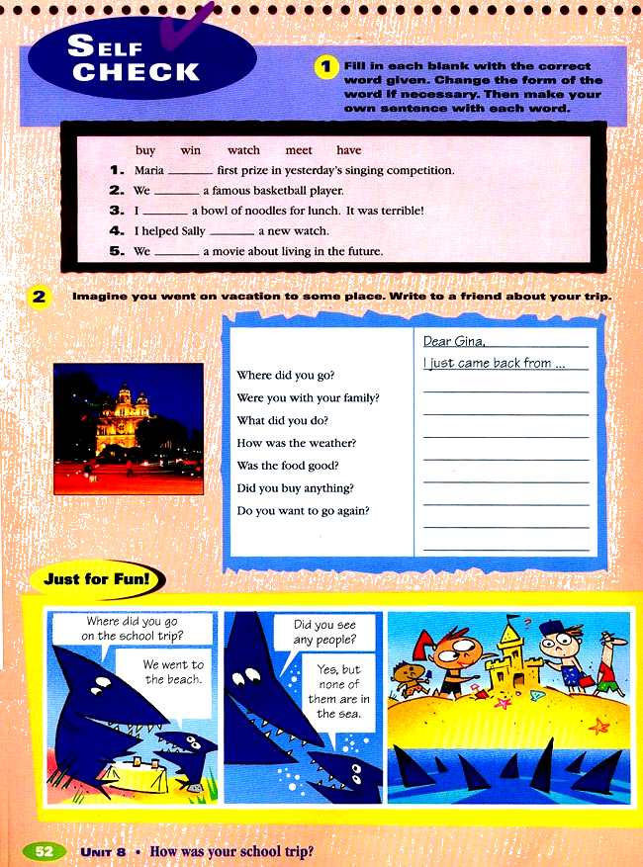
Homework
Write a letter to your friend about what you did in your last trip.

Slide 32
Thank You!

